Slide 1
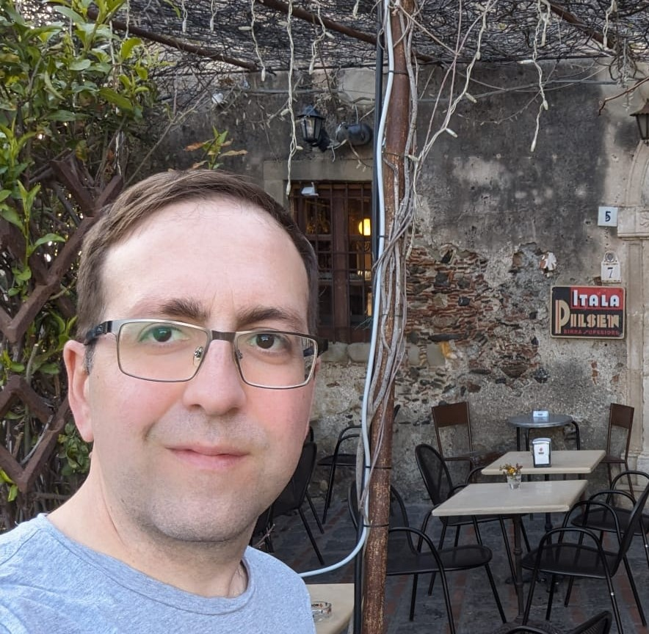
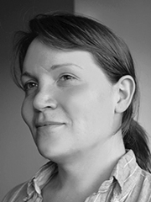
How to measure quality of LLMs
Lessons learned from creating a benchmark dataset for Cyber Threat Intelligence – plus insights from work in progress
Aaron Kaplan (aaron@lo-res.org, AT); Jay Jacobs (Cyentia, US); Paolo Di Prodi (PRIAM AI, GB); Syra Marshall (ELEMENDAR, GB)

Slide 2
Intro speakers & team
Intro AI SIG
What is the benchmark dataset sub-group?
Speakers here: Aaron Kaplan, Paolo di Prodi, Syra Marshall
Wider team: Ben Strickson (Elemendar), David Bianco, Jay Jacobs, Marco Caselli, Patrick Grau, Shin Adachi

Slide 3
Disclaimer
Aaron
All things said and presented here do not represent the European Commission or the Commission’s position nor does it suggest any endorsement
All errors are mine to keep
I present this here as a sole proprietor company under my own name
Jay, Syra, Paolo
They represent their respective companies

Slide 4
Disclaimer Continued!
This is all still very much WIP
We present here to:
Find people who work on similar things
Help people to avoid the same mistakes we did ☺
Learn from each other & collectively improve the work on CTI AI models
So, do not assume this presentation represents something authoritative. We are all discovering….
… because there seems to be no comprehensive, good CTI benchmark dataset for LLMs

Slide 5
Example of popular LLM benchmarks
A little digression
ARC
QA benchmark
Older ones are SQUAD, SNLI
HellaSWAG
Commonsense reasoning
Common, Real world physical scenarios
MMLU
Broad QA benchmark Subjects: STEM, humanities, social sciences and other subjects
GSM8k
Knowledge and Reasoning
Scientific questions
Natural Language Inference
Grade School Math
Multistep mathematical reasoning abilities
HumanEval
Measure ability to generate code
Python coding channelges

Slide 6
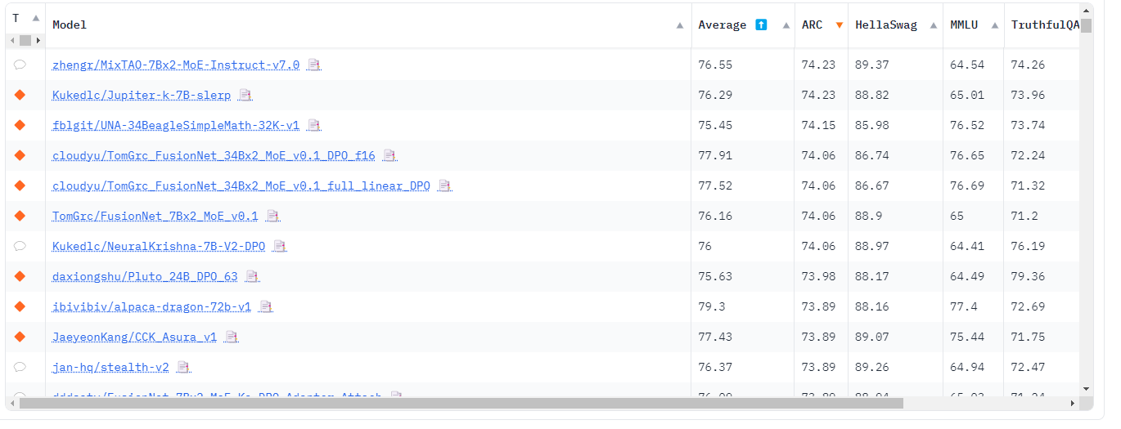
Why leaderboards are important
A leaderboard can tell us if an LLM has achieve comparable or super human capabilities.
For example for ARC, the average human performance is 84%.

Slide 7
Why to use LLMs for CTI?
The goal of CTI is to know where to look (and how to pivot, how to connect the dots and anticipate the adversaries moves)
This implies 5 main uses cases:
UC 1: CTI analysists need to digest a lot of threat intel reports → Summarization
UC 2: Analysts might want to search (question-answering) on CTI reports (+ translation: I-S00N leak) → RAG
UC 3: Analysts would like to get the information out (“information extraction”) from CTI reports → NER
UC 4: Extracting MITRE TTPs from text reports
UC 5: Extract relationships (“Threat Actor xyz is using Tool ABC to achieve 123”) → put into knowledge graph / STIX 2.x

Slide 8
Constraints in the CTI work-environment
Very often, we can not use ChatGPT/openai/anthropic/etc. via API
Data needs to stay internal
Local models FTW!
But: are they just as good?
→
again the need for benchmarks

Slide 9
Core questions to evaluating AI in CTI
For uc in use-cases:
Can we do uc? (does it work with LLMs?)
Can we do it better than humans?
→ score against human
TPR , FPR, etc. metrics
When we have a FP, can we detect it?
How do we need to integrate uc into our workflow? Where is the human-in-the-loop?

Slide 10
Existing data and benchmark datasets
How the sausage is made?

Slide 11
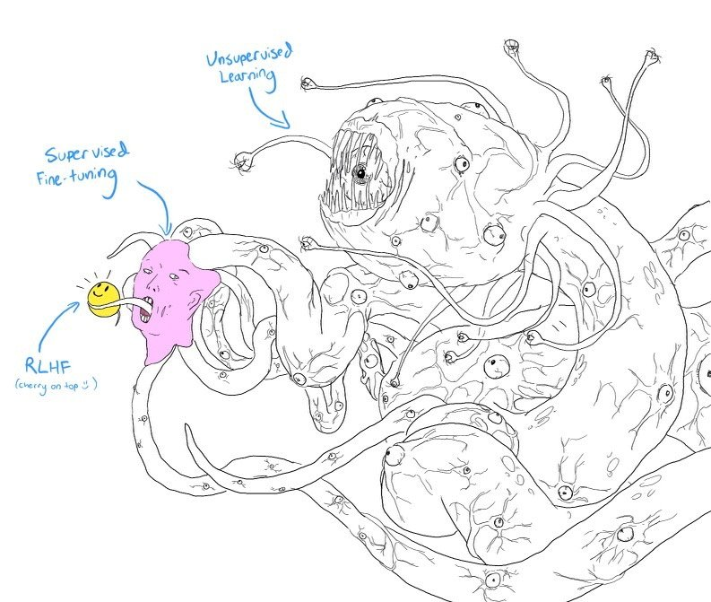
A monster!
How do you feed this monster?
To produce a jewel?
We need lots of data but that is already available
We need feedback data for each specific task
That is kind of doable!

Slide 12
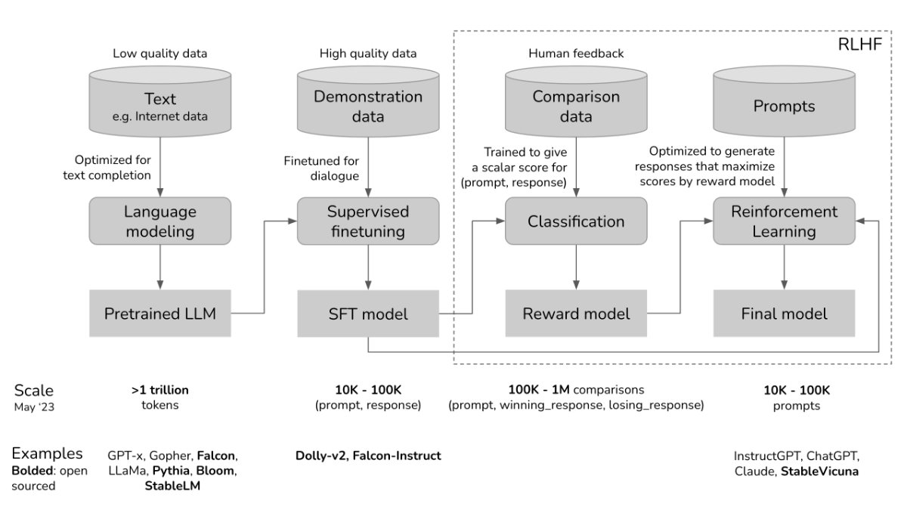
The major cost is human annotation …

Slide 13
What do we have available already?
MITRE
ATT&CK v14
October 31 2023
PAN UNIT42
83 playbooks
Encoded as STIX 2.0 and ATT&CK
CISA Advisories
128 reports
625 categories
201 parent techniques
424 sub-techniques
A playbook: one intrusion set, one or more campaigns, zero or more indicators, one or more attack patterns
Average: 2 release per year
AnnoCTR
Curated by Bosch TI
11 are in JSON STIX format
111 are in old XML STIX 1.0 format
Contains a PDF
IOC as XML and JSON
Also refers to ATT&CK framework with v14 as the latest
MITRE TRAM
Feedly: filtered news articles
Reports from 03/2013 to 02/2022
400 public threat reports
CC-BY-SA licenced from
5 commercial vendors: Intel471, Lab52, QuoIntelligence, Zscaler
CTI reports + technique labels
Last update: 27 August 2023
Most common 50 Techniques
Based on SciBERT

Slide 14
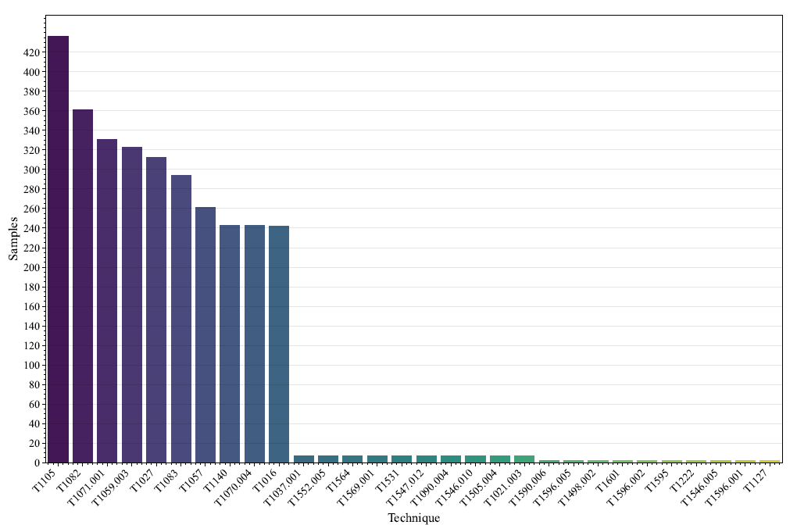
MITRE dataset
A classification task with 625 categories
Absence of Procedure examples for 108 techniques like T1559.003, T1547.003
Duplicate procedures: “APT18 actors leverage legitimate credentials …” involves 2 techniques: T1078 and T1133
A total of 82 categories have duplicates items: 163 samples
After deduplication the basic training set is 14,123 samples.
The distribution is extremely uneven: the smallest one being 2 and the largest one being 436.
There are multiple ways to solve this problem from traditional methods like SMOTE to GPT4 for augmentation.

Slide 15
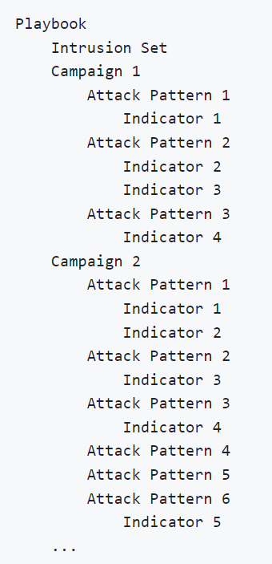
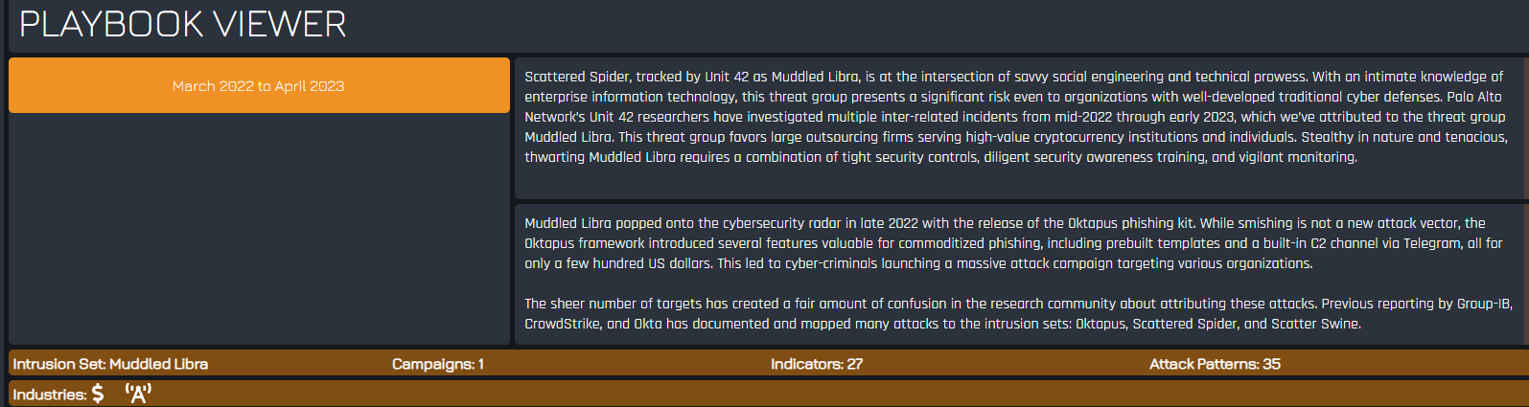
PAN UNIT42 dataset
There are 83 playbooks in STIX format
It doesn’t contain the original textual article
Using Langchain search finding possibly relevant articles: 299 pairs

Slide 16
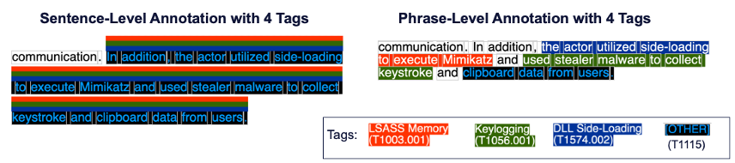
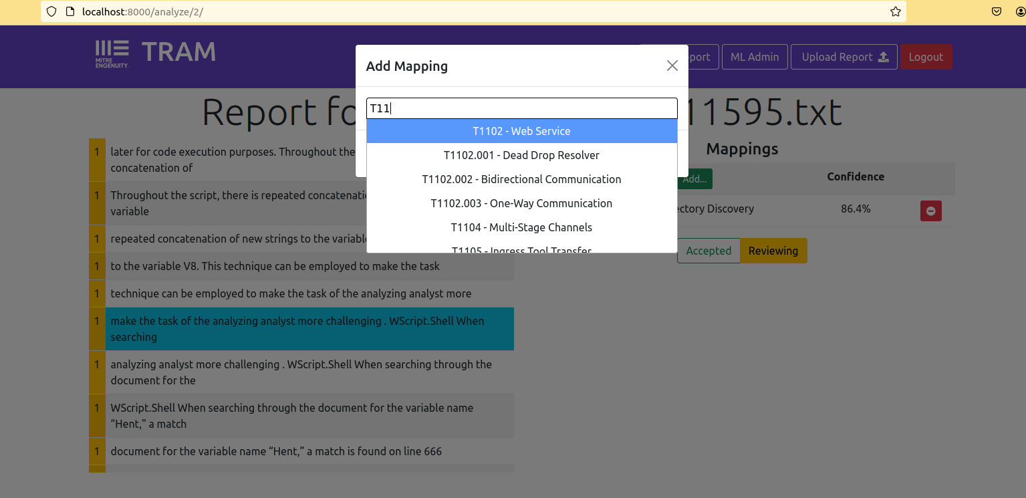
MITRE TRAM dataset
Multi Label: JSON file with sentence-level annotation
Single Label: JSON file with phrase-level annotations

Slide 17
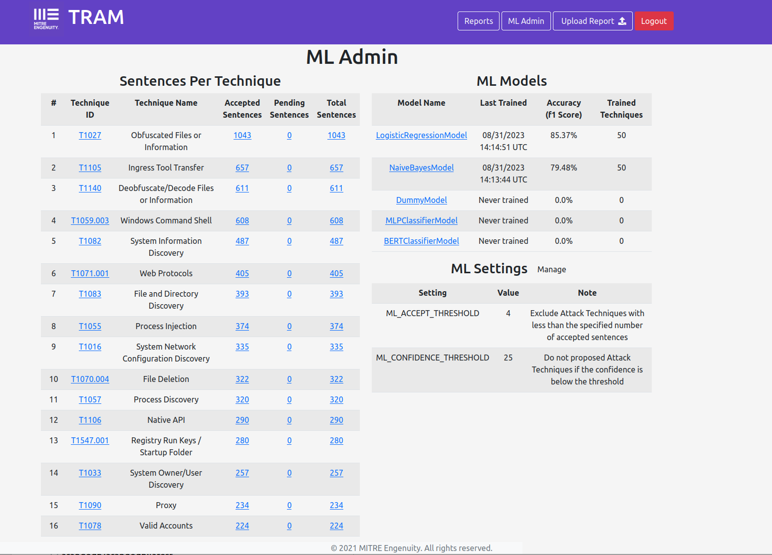
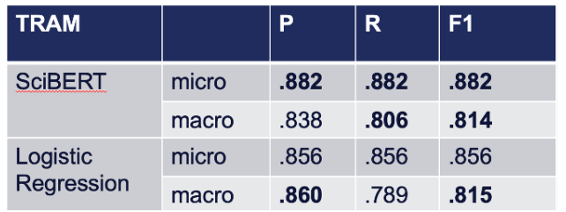
Scibert beats GPT2 and base bert. It also beats a classical Logistic Regression model except in two metrics. TO DO: try LLama2 and GPT4 on the same dataset
SciBERT: BERT trained on scientific text, corpus size 1.14 M papers, 3.1B tokens, origin: semanticscholar.org

Slide 18
CISA Advisories

Slide 19
Insight: we need a benchmark dataset
Within the AI SIG, we realized …

Slide 20
UC 1: Summarization
Aaron Kaplan

Slide 21
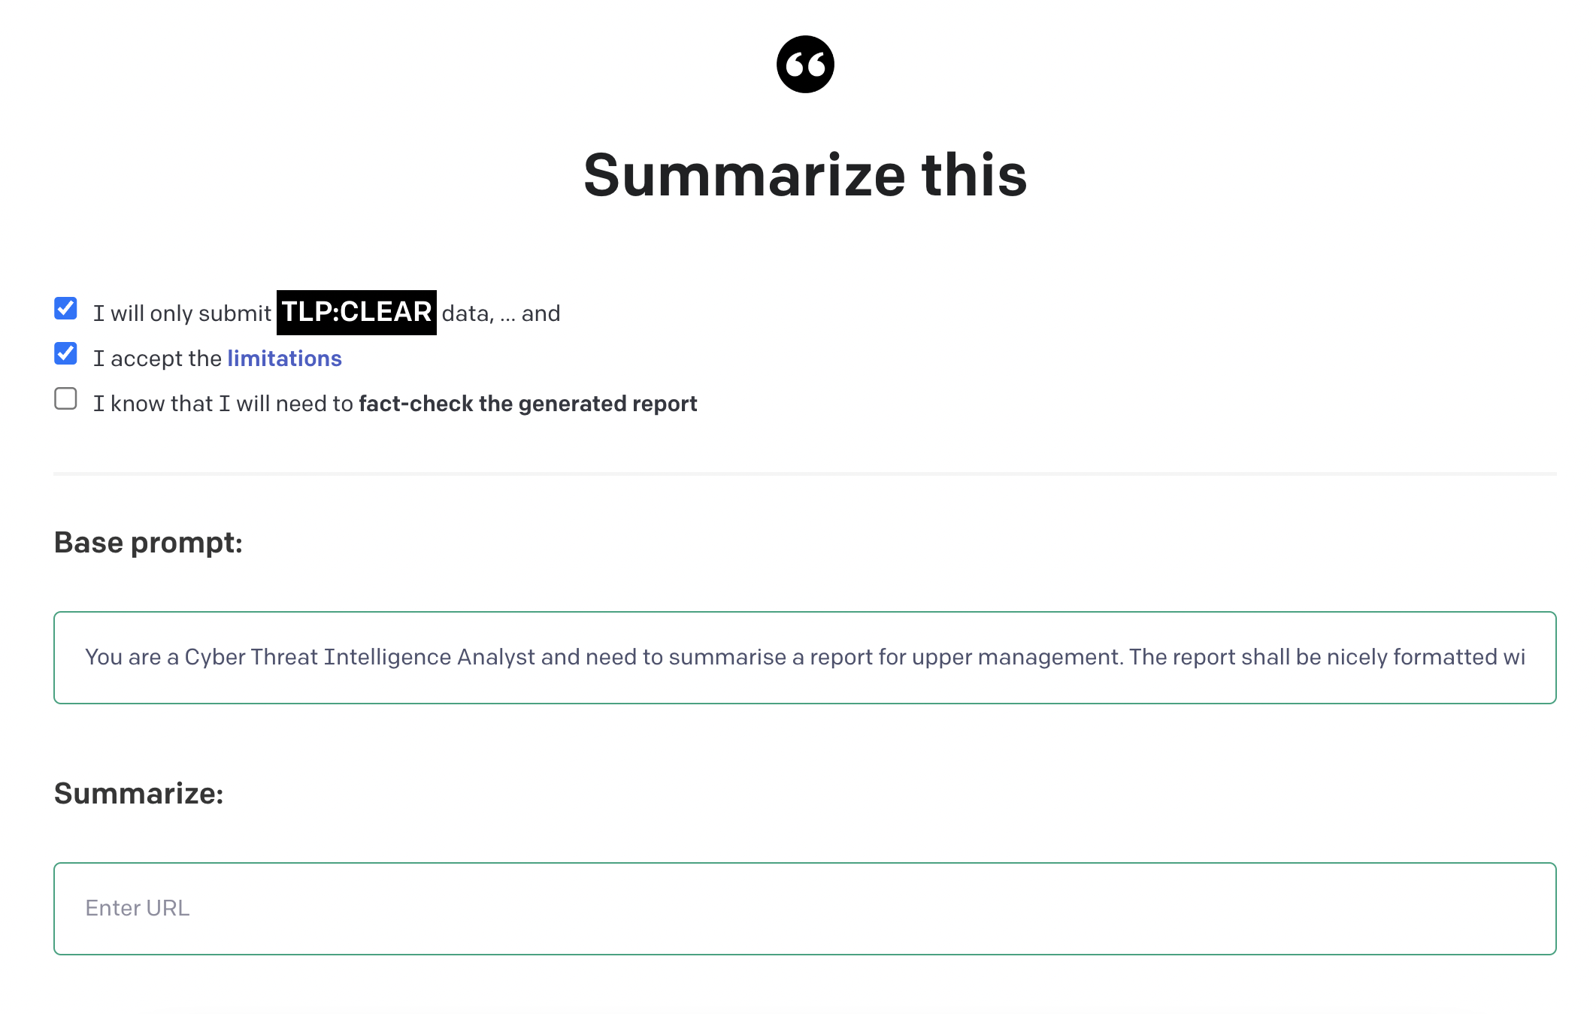
Summarization: a very first naïve approach

Slide 22
Example use-case: summarization
Is there an existing good CTI summarization benchmark? NO!
How is it even possible to compare summaries?
First naïve approach: let humans compare AI summaries vs. human summaries
XXX screenshot & show XLSX sheet, explain:
50 CTI reports
Score -10 (AI == really bad) to +10 (AI is much better than human). 0 == equally good/bad
Average score: 4.7 (!)
85% of cases AI > human
Std-dev high (if the AI is wrong, it’s very easy to spot)

Slide 23
Problem with the naïve approach + solution
Human comparison == ultimate gold standard, but
It does not scale
Enter “Human-like Summarization Evaluation with ChatGPT”, Mingqi Gao, et. al.
https://arxiv.org/abs/2304.02554

Slide 24
Human-like Summarization Evaluation with ChatGPT
Core Idea:
automatic evaluation algos (ROUGE, BERTScore , BARTscore, …)
vs. human evaluation (Likert scale scoring, Pairwise comparison, …)
Can we use gpt-3.5-turbo¹ for simulating a human evaluation?
Turns out, we can
Likert scale score: “given a source document and a generated summary, annotators rate the summary on several dimensions. Typically, this is an absolute evaluation, meaning each summary is evaluated individually without explicit comparison to other summaries. Dimensions usually include factual consistency, informativeness, fluency, etc. The rating scale is usually 1 (worst) to 5 (best).”
[1] gpt-3.5-turbo-0301

Slide 25
Existing automatic evals
ROUGE: comparing via tri-grams/n-grams. Family of standard metrics. “The most commonly used ROUGE measures are ROUGE-1, ROUGE-2, and ROUGE-L, which evaluate the similarity be- tween two texts based on the overlap of unigrams, bigrams, and the longest common sequence. “
BERTScore: “BERTScore (Zhang et al., 2020) assesses the similarity between two texts at the token level by measuring the soft overlap using contextual embeddings from BERT.”
COMET MT benchmark

Slide 26
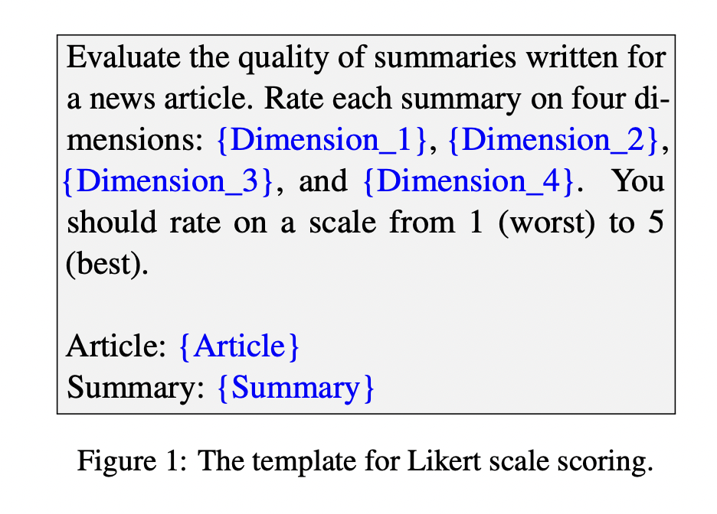
Simulating the Likert Scale score

Slide 27
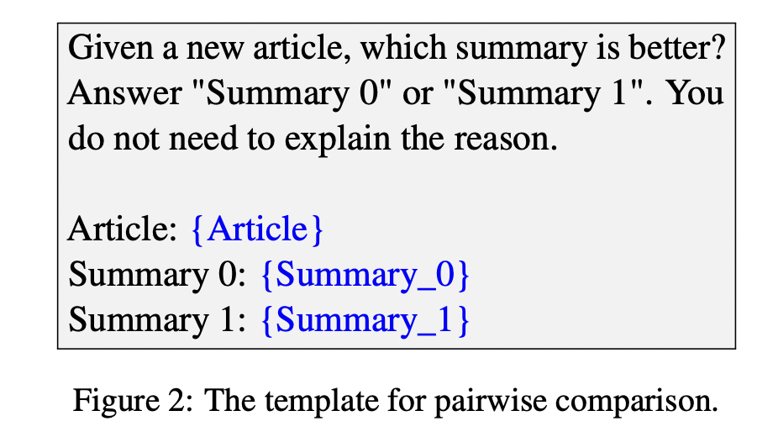
Pairwise comparison simulation

Slide 28
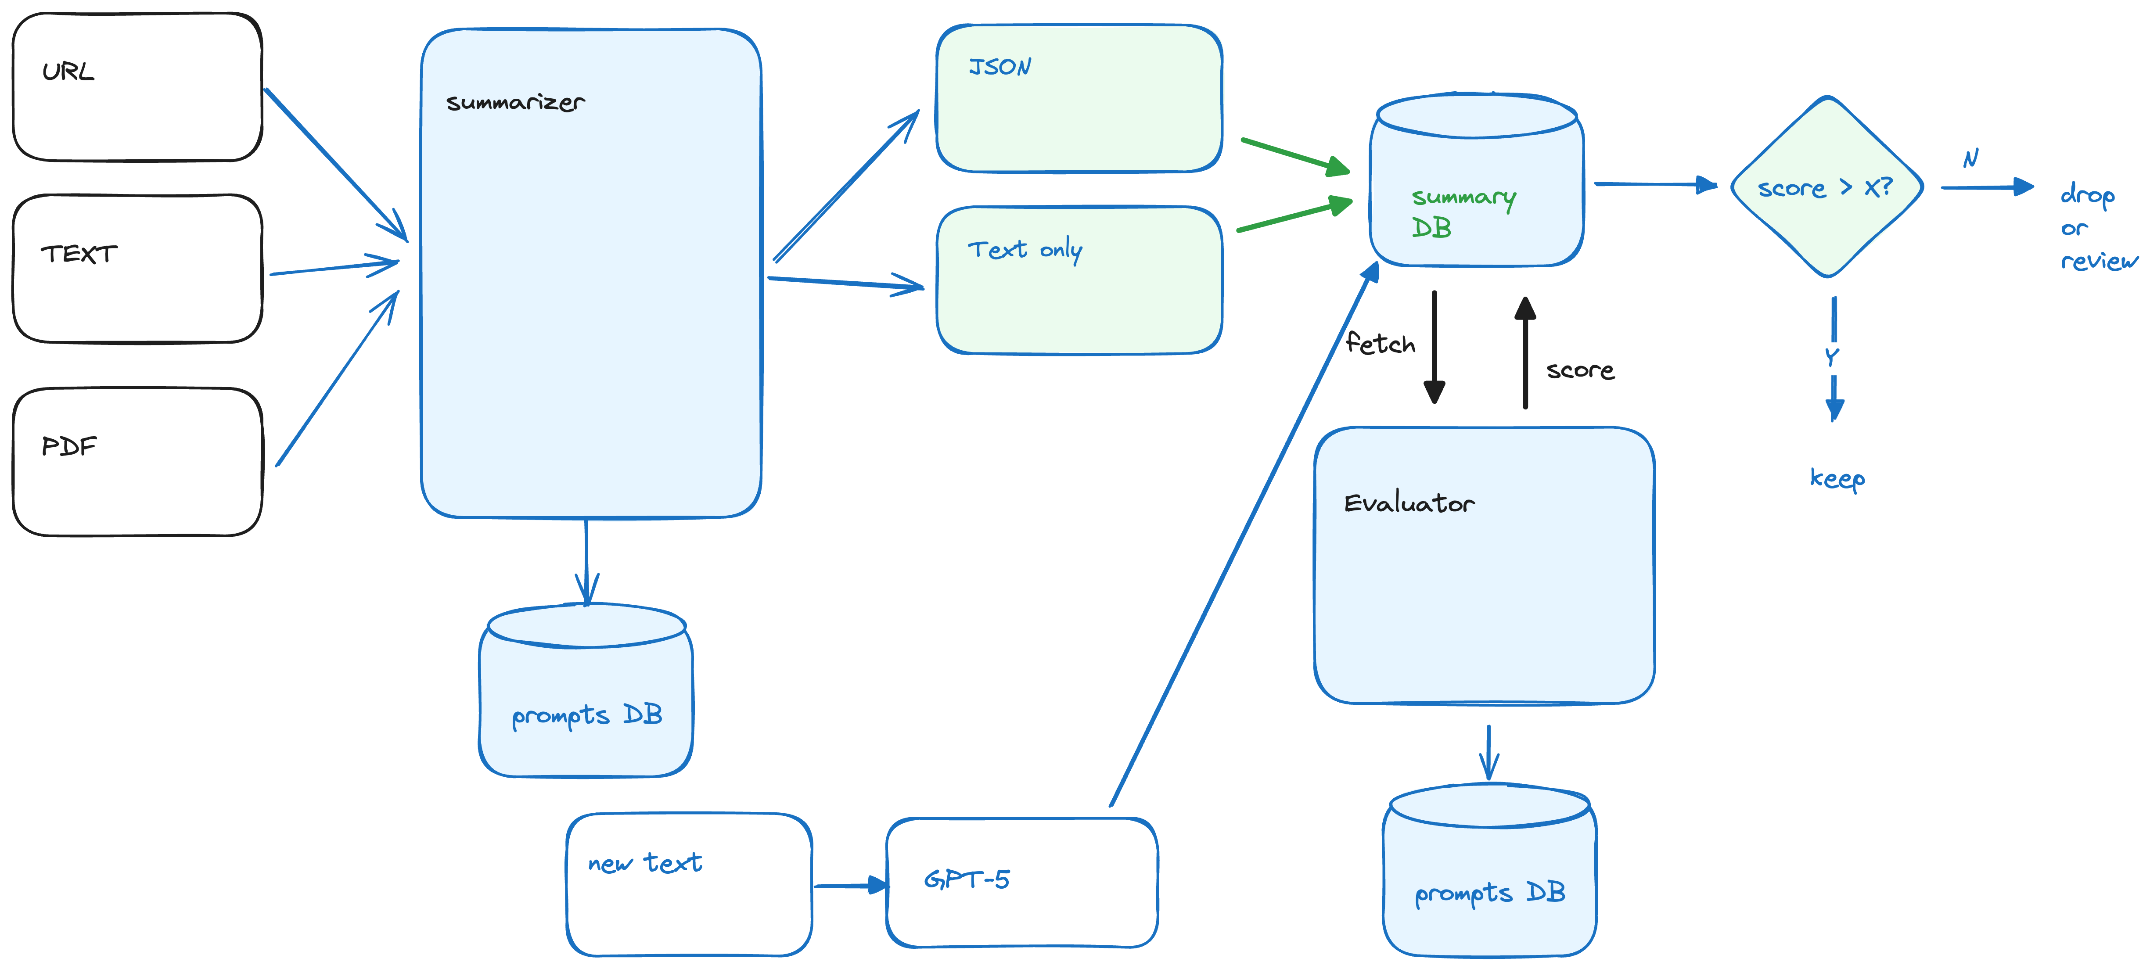
Current architecture

Slide 29
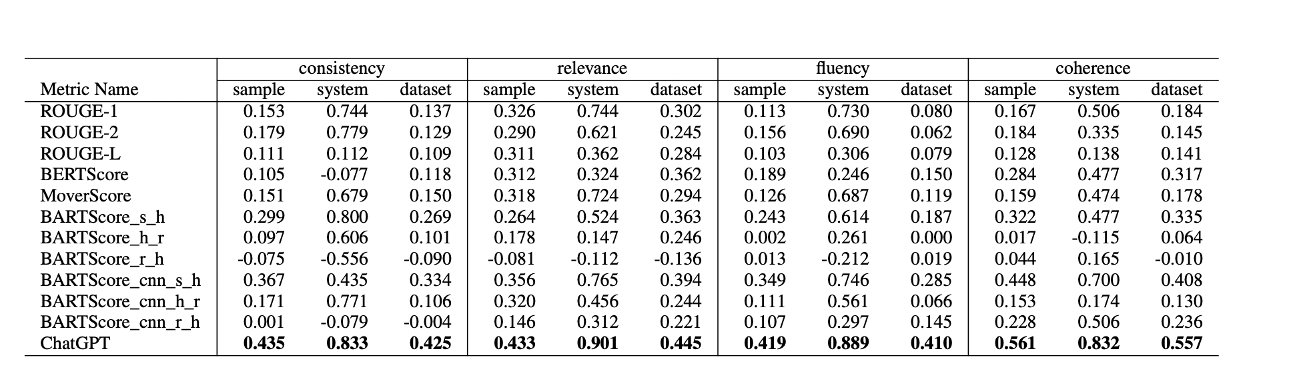
Results¹
[1] Source: https://arxiv.org/abs/2304.02554

Slide 30
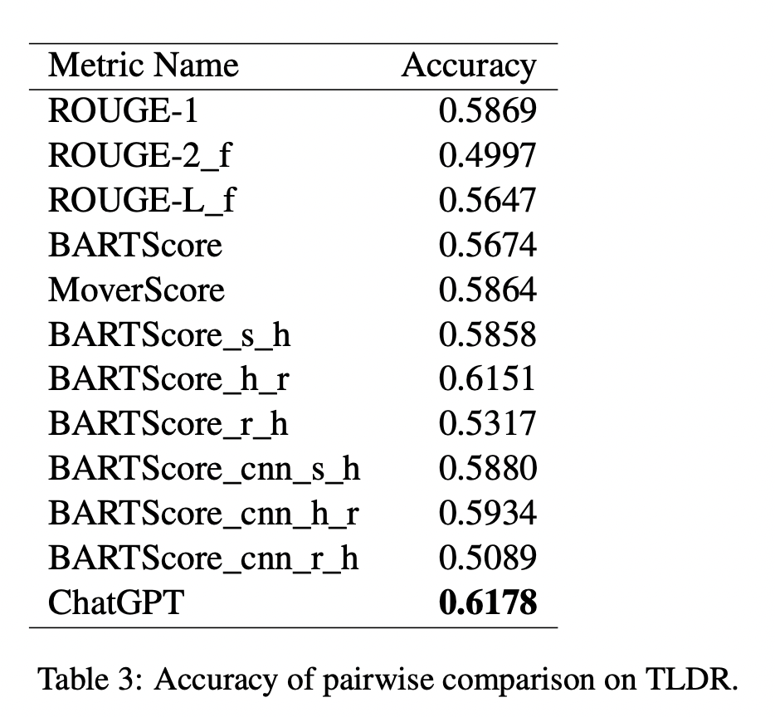
Results (cont)
It works
Why??
Theory: lots of data out there on rating essays etc. (?)

Slide 31
Dataset
… XXX aaron XXX
Description of the data
URL on where to get it

Slide 32
Problems ?
Aren’t we introducing bias, problems etc. bc. we don’t use humans?
Maybe. But it’s a statistical argument of error rates on a meta-level.
Other groups are using GANs to check the quality of a summary
This is WIP.
No one seems to have a perfect solution currently

Slide 33

Conclusion summarization benchmarking
It seems that we can use LLMs for simulating human evaluation of text quality (summarization)
Which allows us to create a large benchmark dataset of CTI text summaries.
With that summary dataset (WIP) we will
Make sample checks
Estimate the error rate of the simulated human eval
Estimate the total error
Can train / fine-tune models
Or evaluate new models w.r.t to summarization of CTI texts

Slide 34
UC 2: RAG
Paolo & Syra

Slide 35
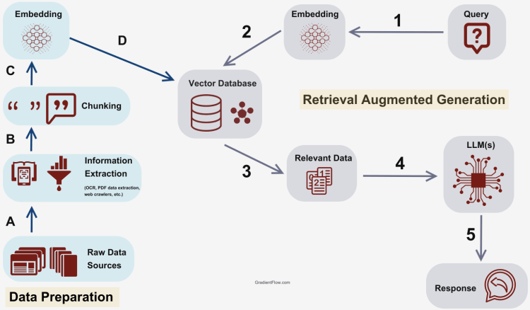
What is RAG: Retrieval Augmented Generation
Many Vector stores to choose from
Smaller models outperforms bigger models!
Many LLM to choose but consider:
Accuracy, latency and cost
Mixture of experts: use multiple LLM agents
Intent classifiers: Naïve Rag vs Chat
Chunking >> Embedding
Choose a high fidelity extractor!
Quality, Meta data, Bias…

Slide 36
What is RAG: Retrieval Augmented Generation
RAT = RAG + COT
RA-DIT: retrieval tuning
Prompt Engineering
Chain of Thought, Step-Back
Knowledge Graphs
Self-RAG: learn via self-reflection
Embeddings
Hybrid Search: hypothetical queries, summaries, parent retriever, RRR
RAG fusion
Multi Query
Chunk Sizes
REALM: retrieval augmented pre-training
Metadata Filters
Simple
Complex
Notes:
https://github.com/weaviate/Verba/issues/90

Slide 37

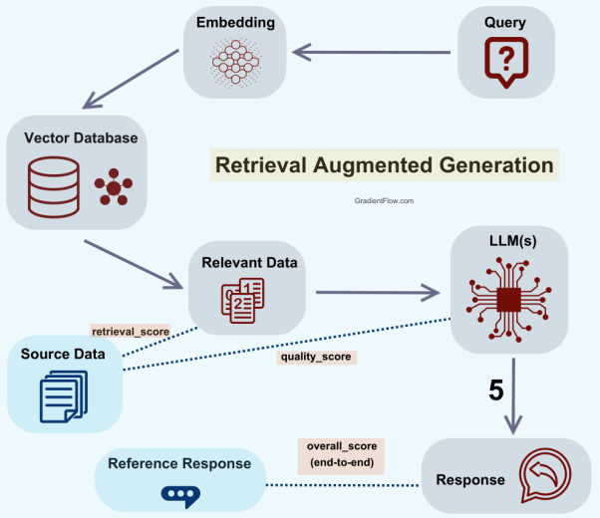
How to benchmark RAG?
Component wise
We need human annotators too!
End to End via a QA
Automated via RAGAS

Slide 38
Standard metrics to consider
Exact Match
The percentage of queries that are answered correctly
Recall
The % of queries that are answered correctly, regardless of the number of answer returned
Precision
The % of queries that are answered correctly, divided by the number of answers returned.
F1
Harmonic mean of precision and recall
Considers both TP and FP
There are also more complex metrics such as NDCG, MAP and MRR that can be used later.

Slide 39

Guardrails
Even with RAG techniques there is still risk of confabulation aka hallucinations, one more reason to have a curated test set.
Using Knowledge Graph driven RAG and “classical” NLP techniques can help check for that and provide sources for validation

Slide 40
UC 3:NER
Paolo & Aron

Slide 41
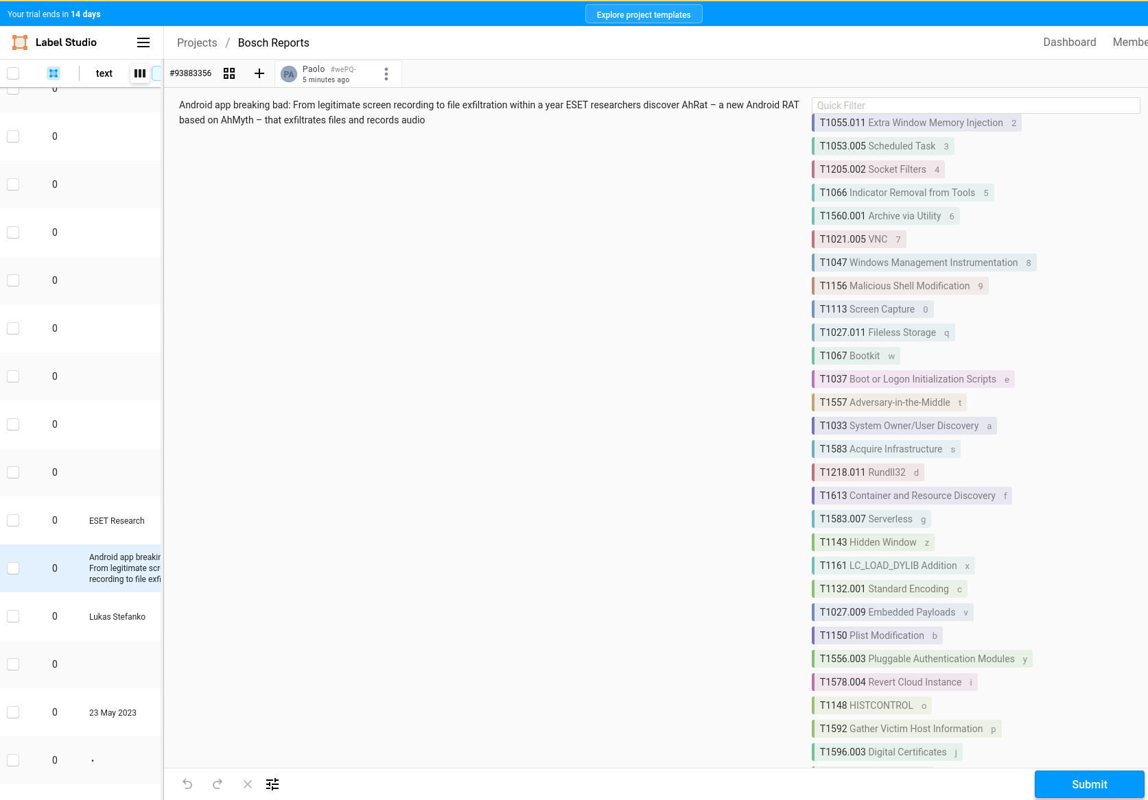
Annotation tools
Threat Intelligence annotation is a challenge for traditional NLP tags
High cardinality of entities and relations
Needs to support mnemonics
We tried: Doccano, John Snow Labs, Labellerr, TRAM
We gave up and now building a specific one

Slide 42
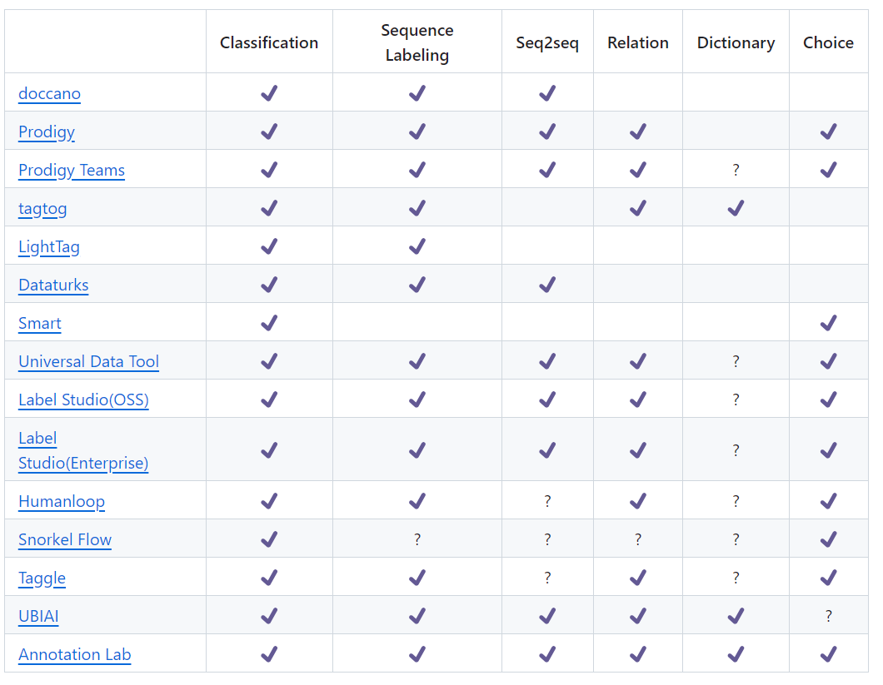
Main pain points:
We have a very large taxonomy from STIX2.1, MITRE, MISP
We are dealing mostly with text, we don’t care about images.
The core tasks for us are: NER labelling, text classification.
We need multi-user collaboration features.
It must export in a common and open format to then enable training and inference.
It needs to be affordable: prices ranges from 500 USD a month to 5000 USD a month.

Slide 43
CyNer on steroids
Text
Regex
SDO
Spacy
RoBERTA
FLAIR
SDO
SDO
Spacy-LLM
SDO
SRE
SDO

Slide 44
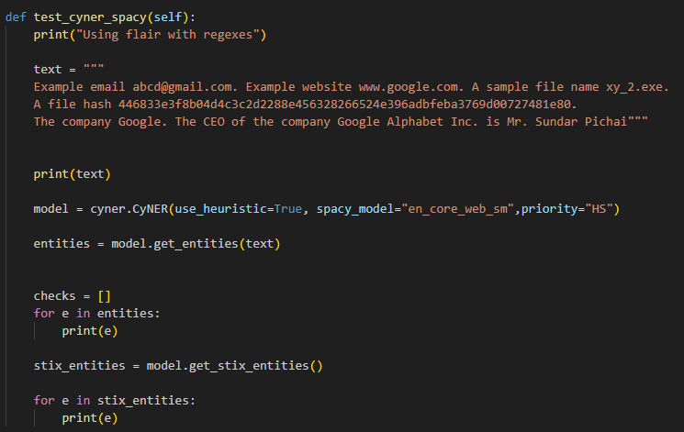
Logic is simple: text input output tags
TEXT
DeFanging
Regex
Spacy/Flair
Roberta
LLM
STIX SDO
STIX SDO
STIX SDO
STIX SDO
STIX SRE
STIX based entities
Entity: xy_2.exe, Class: file.name, Start: 90, End: 98, Confidence: 1.00
Entity: abcd@gmail, Class: email.value, Start: 23, End: 33, Confidence: 1.00
Entity: www.google.com, Class: domain-name.value, Start: 54, End: 69, Confidence: 1.00
Entity: Google, Class: location, Start: 208, End: 214, Confidence: 0.98
Entity: Google Alphabet Inc., Class: location, Start: 239, End: 259, Confidence: 1.00
Entity: Sundar Pichai, Class: identity.name, Start: 267, End: 280, Confidence: 0.92
MERGE Priority
Params
Spacy Model
Priority
Regex
Flair Model
GPT Model

Slide 45
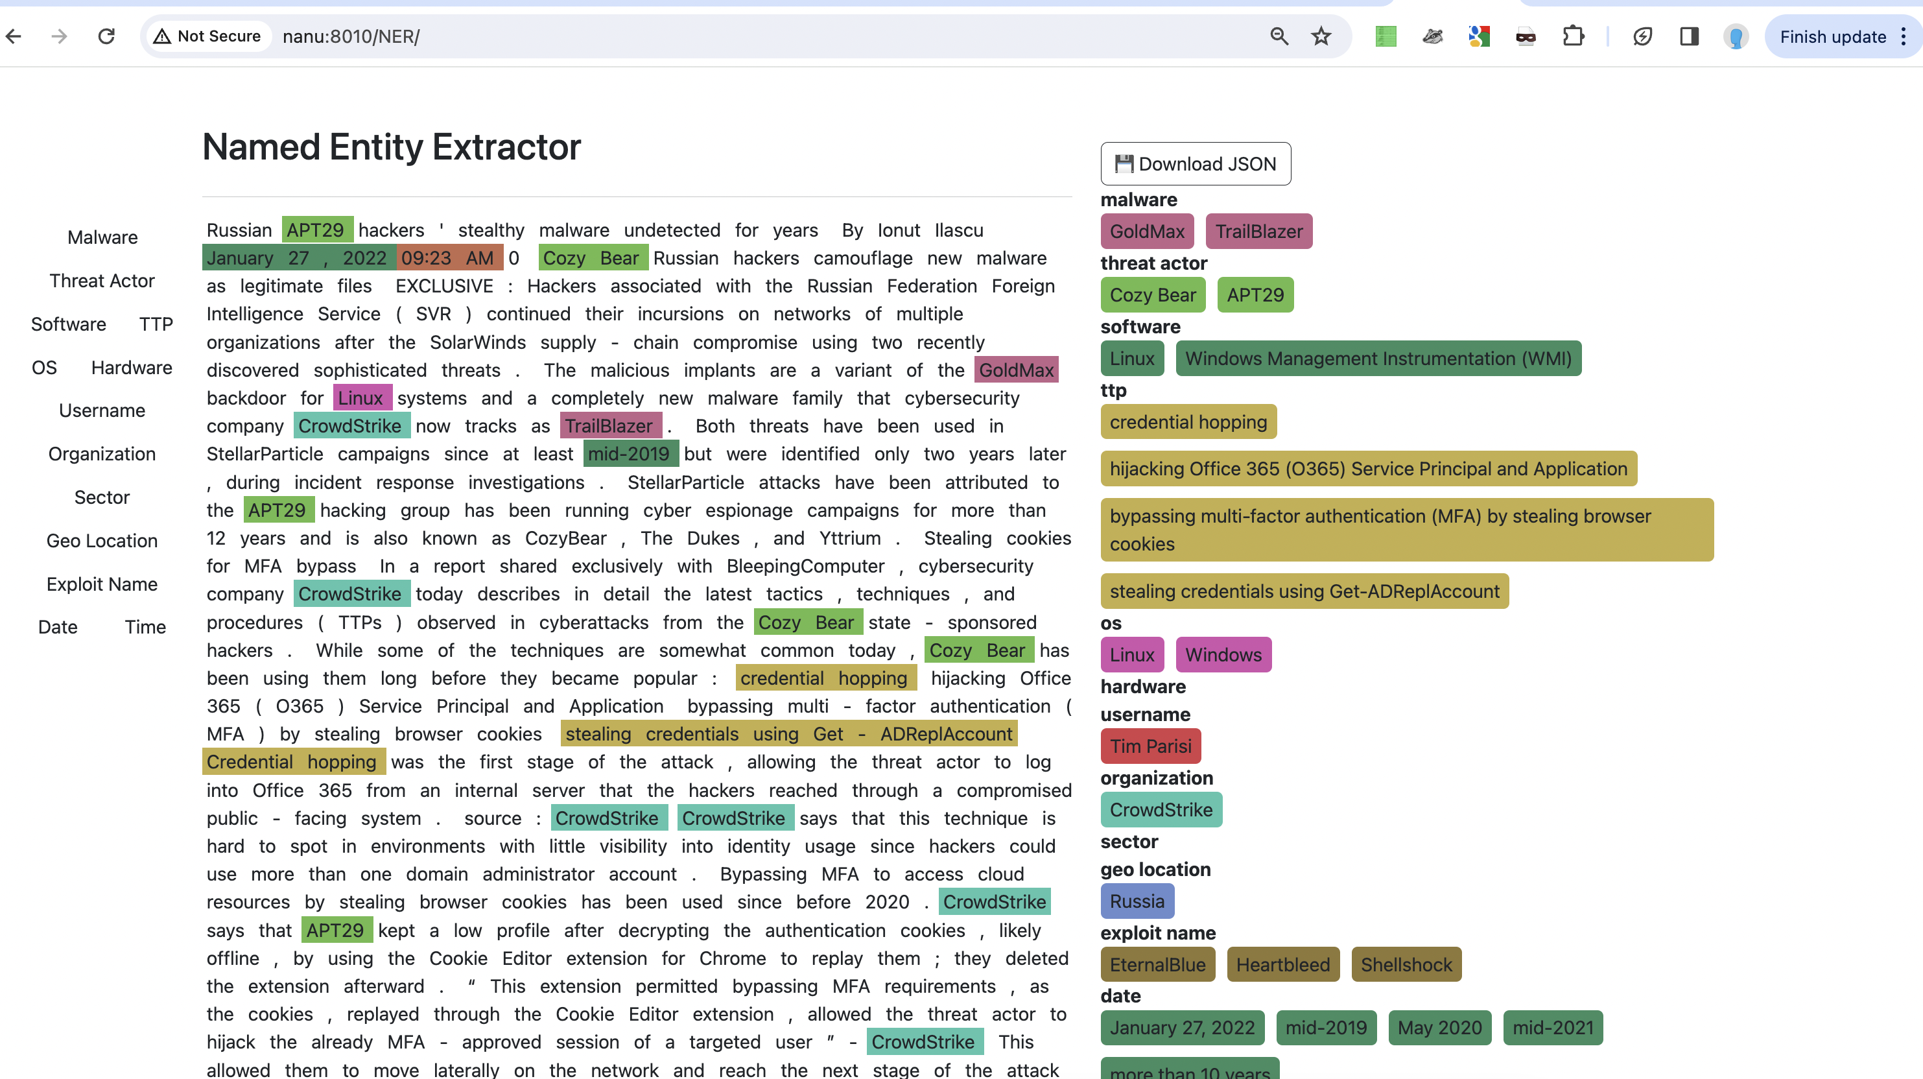
Evaluation NER
Use people ☺ + gamification

Slide 46

On boarding annotators!
Intro & Demo of the NER system
Please send an email to: admin@priam.ai
Subject title: human annotator
Benefits:
In exchange for your time you will get access to our early pre-trained models
Once they system is live you will receive a user account

Slide 47
UC 4: classify text for MITRE TTP
Paolo

Slide 48
CyClassifier
Text: sentences or chunks
TRAM
TTP single
LLAMA2
GPT4
TTP single
TTP multiple

Slide 49
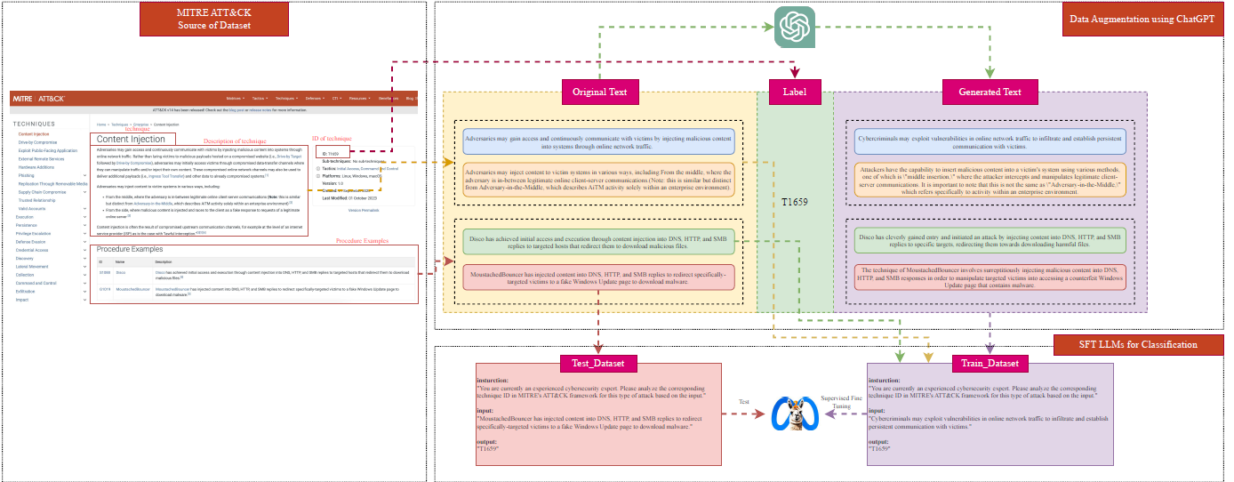
LLAMA2 fine tuning early results
MITRE ATTACK
Descriptions and Procedures
LLama2-7B
Classify Text Chunks
Without resampling performance is not great ….

Slide 50
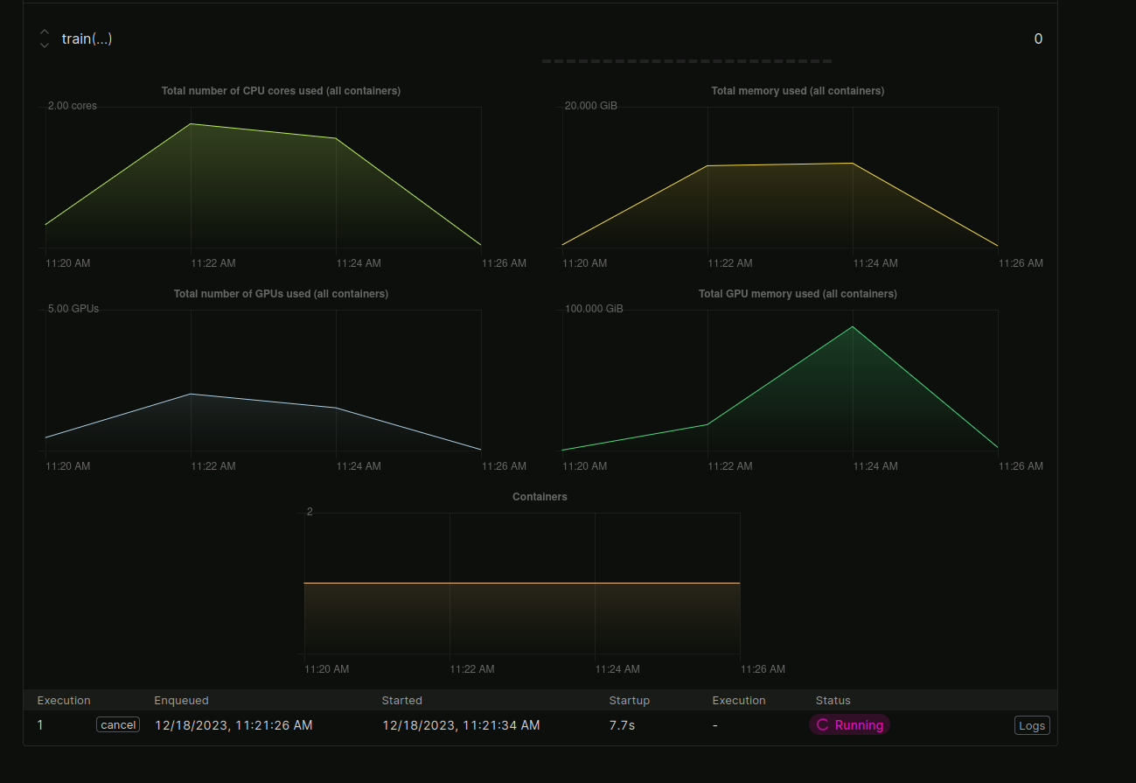
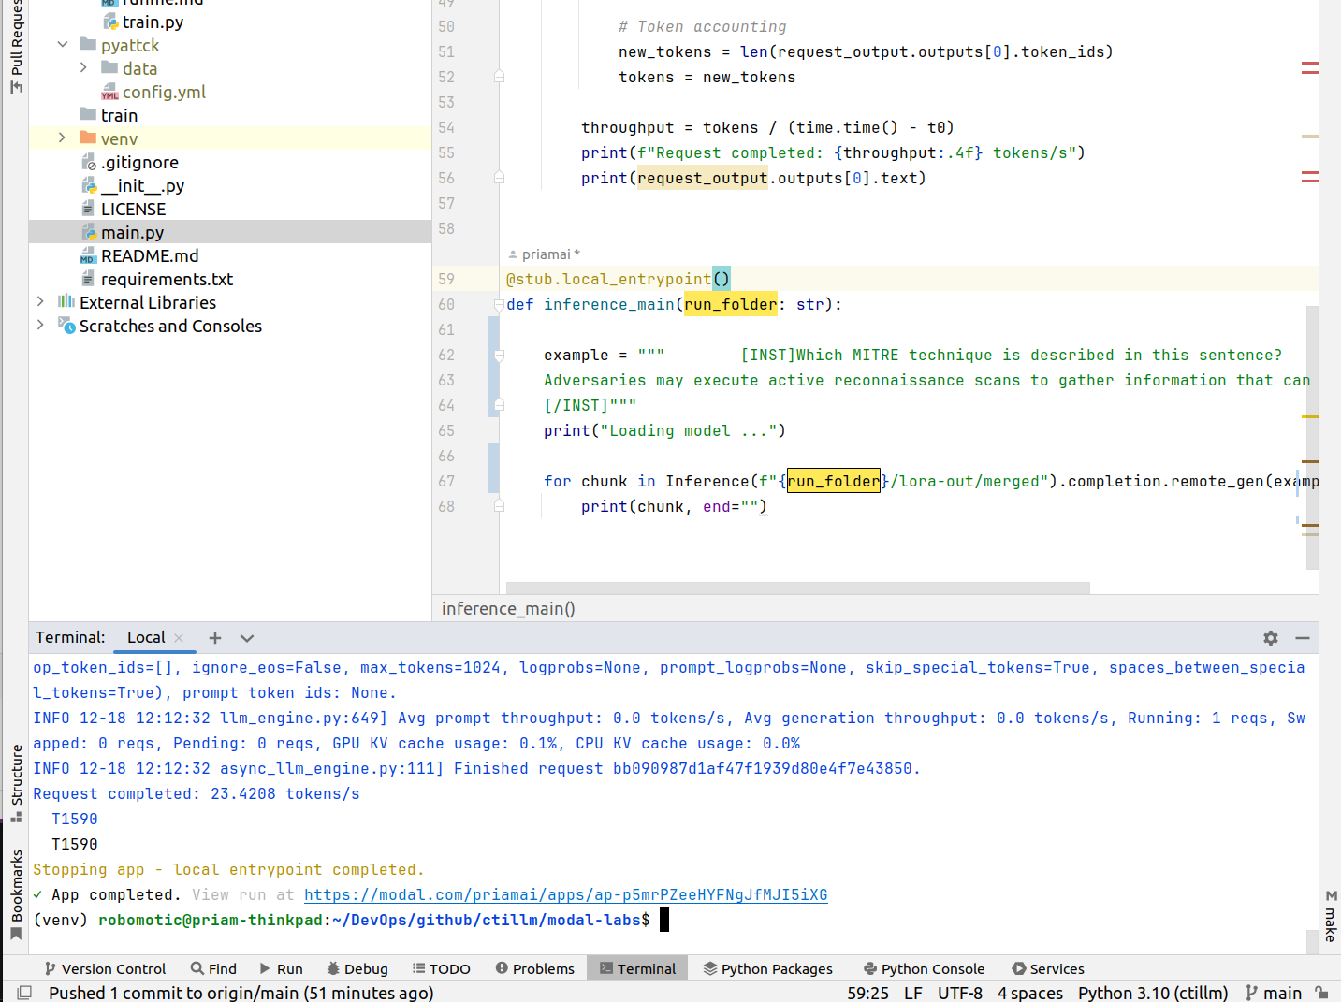
The fine-tuned checkpoint is shared
Trained on a A100 it took 10 minutes.
Model | P | R | F1
LLama2 | 24.5 | 36.8 | 29.41
After Re-Sampling: techniques <=6
Model | P | R | F1
LLama2 | 32.5 | 44.1 | 37.42
Adding more sampling should improve F1

Slide 51
UC 5: knowledge graph (STIX) unification
Syra Marshall (CTO, Elemendar)

Slide 52
A path to STIX…. graphs
Report
STIX extractor
Human Supervision
STIX bundle
Knowledge Graph
Source 1: bundles
Source 2: bundles
Source 3: bundles
Graph Based RAG

Slide 53
Creating STIX from text!
TEXT
NER
RE
Intermediate
SDO
SRO
STIX 2.1
Creating a compliant JSON STIX2.1 file from text via an LLM is a challenge
UUID: needs to have a format and randomized
There are 18 SDO
There are 3 generic SRE and 21 specific SRE + Sighting
The trick is to extract the key entities
And then produce the STIX bundle via a simple logic

Slide 54
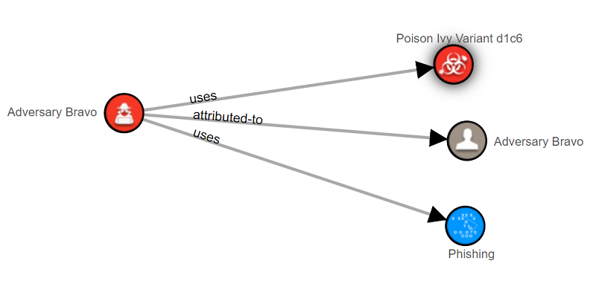

You’ve got a graph, make it better!
STIX graphs for individual documents are great, but…
The power is in combining them to see the whole picture
Powerful techniques of RAG based on hybrid search can be applied to answer complex queries.

Slide 55

Challenges
Confidence
Duplication
Naming Conventions and Aliases

Slide 56
Getting the code & data

Slide 57
Public release of the code
https://github.com/aaronkaplan/cti-llm/
XXX better place? Org name? XXX

Slide 58
Key take-aways
LLMs are super interesting, but without benchmarks, it’s like flying without radar and without GPS: you are nearly blind
Creating good benchmarks is hard
No specific CTI benchmark existed
We are attempting to create one, it’s WIP.
We would like to get your help (NER)

Slide 59
Your ideas?
Are you working on something similar? → let’s talk.

Slide 60
Let’s get in touch & thanks!
AI SIG subgroup on a benchmark dataset

